Slide 1
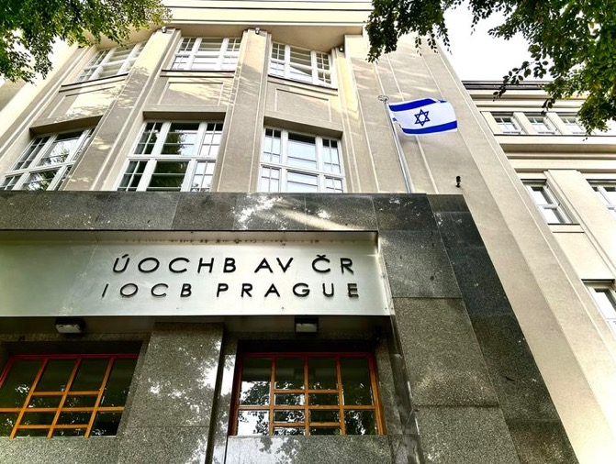
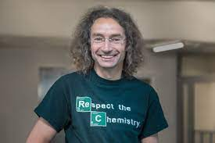

My work at IOCB

Slide 2

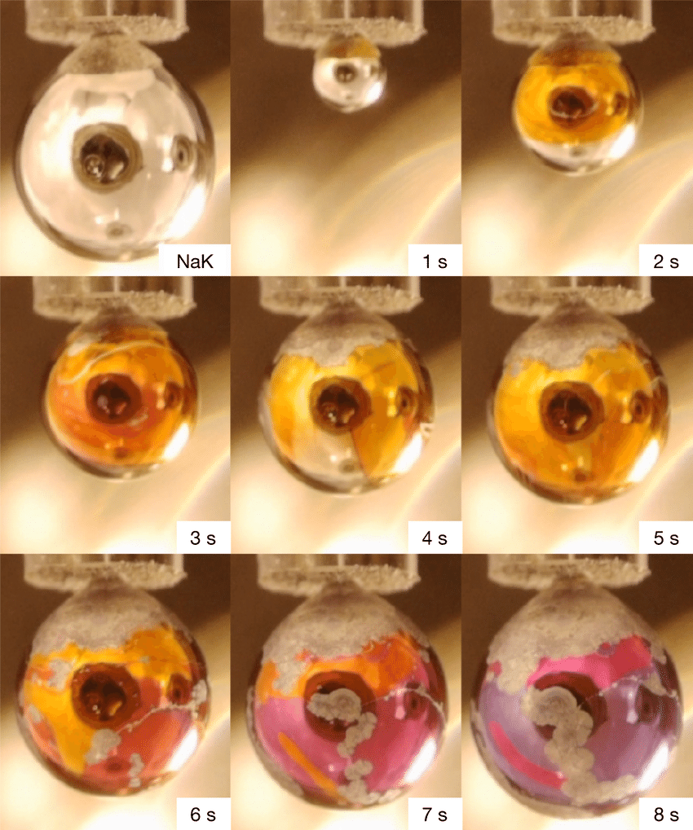
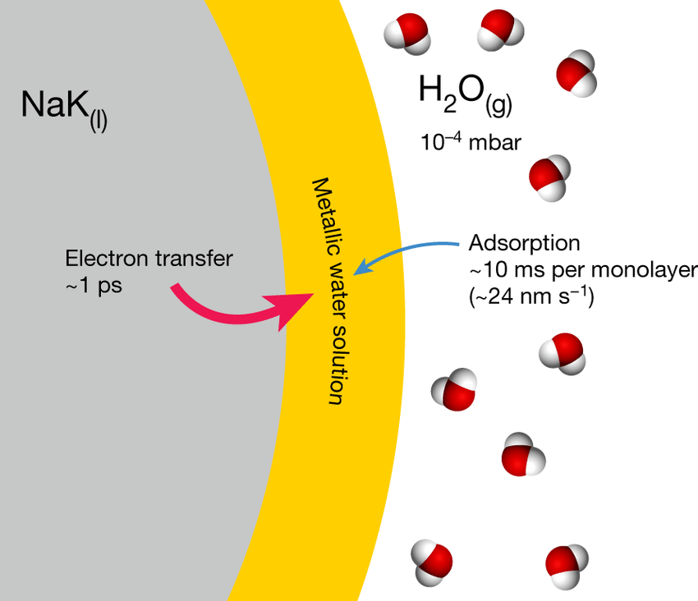
Metalic water?

Slide 3
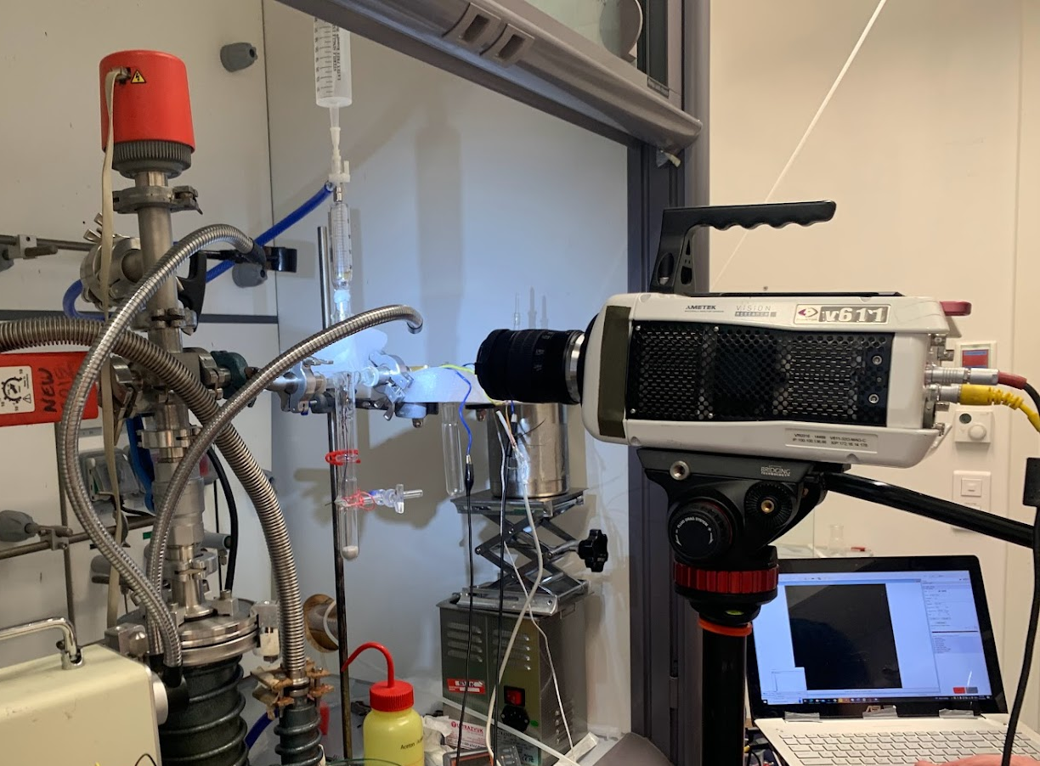
When is too fast to see, but too important to miss!!!

Slide 4
Seeing is believing!
High Potassium alloy bursting in vacuum

Slide 5
Mason, Philip & Schewe, Hanns & Buttersack, Tillmann & Kostal, Vojtech & Vitek, Marco & McMullen, Ryan & Ali, Hebatallah & Trinter, Florian & Lee, Chin & Neumark, Daniel & Thürmer, Stephan & Seidel, Robert & Winter, Bernd & Bradforth, Stephen & Jungwirth, Pavel. (2021). Spectroscopic evidence for a gold-coloured metallic water solution. Nature. 595. 673-676. 10.1038/s41586-021-03646-5.

Slide 6


